Slide 1


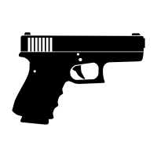
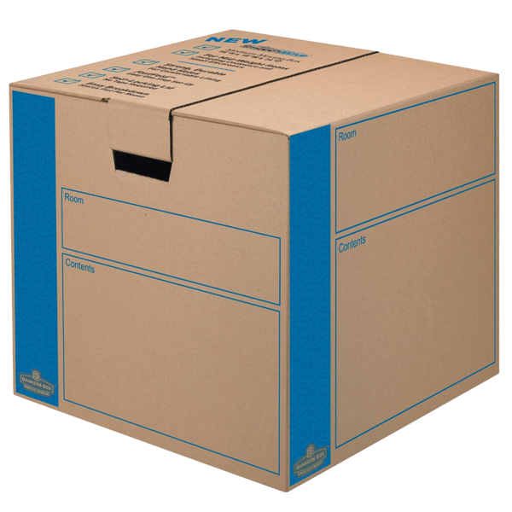

 | Heavy Boxes Course Designer: Kris Erickson |  |  |  |  | Bay 6
"I've held an AR-15 in my hand…It is as heavy as ten boxes that you might be moving. And the bullet that is utilized; a .50 caliber, these kinds of bullets need to be licensed and do not need to be on the streets.” – Rep. Sheila Jackson Lee (D-TX). SCENARIO: While hauling the last heavy box of your AR-15 .50 caliber pistol clips to your gun room, you notice that your domicile is under attack. Get that box to your gun room, quickly assemble your fully licensed pistol, and repel the intruders.
START POSITION: Standing at start position, heels on marks, facing downrange, holding box by handles with both hands. All magazines to be used on the stage are in the box. Gun is unloaded, pointing downrange on table at P1. |  | STRINGS | CONCEALMENT |  | SCORING |  | TOTAL ROUNDS
 |  | 1 | OPTIONAL |  | UNLIMITED |  | 14
 |  | TARGETS |  | 7 threat.
 |  | SCORED HITS |  | Best 2 per target.
STAGE PROCEDURE: At signal, move to table, stow spare magazines, THEN load gun and engage T1-T3 from P1. Engage surprise targets T4 & T5 on the way to P2. Engage T6 & T7 from P2.
 |  | NOTES:
T1 – T3
T4 & T5
T6 & T7
P2
P1
START
https://youtu.be/5CKOFGYkO0g?t=28

